Slide 2
This presentation is not intended as a substitute for professional medical advice, diagnosis, or treatment.​
Never disregard professional medical advice or delay seeking it because ​of something you have read or seen in this presentation.​
This presentation was developed by​ Jazz Pharmaceuticals for promotional use and is not eligible for CME credits.​

Slide 3


MANY SEIZURES ARE HARD TO SPOT IF YOU DON’T KNOW WHAT TO LOOK FOR
Looking out for seizures means looking out for your residents—because seizure care starts with you.
Even seizures that don’t look obvious can still have an impact on the brain.^{1,2}
This presentation is designed to help you recognize the signs of many seizure types, and how to report what you see.
References: 1. Nicolai J, Ebus S, Biemans DP, et al. Epilepsia. 2012;53(6):1051-1059. 2. Aldenkamp AP, Overweg J, Gutter T, Beun AM, Diepman L, Mulder OG. Acta Neurol Scand. 1996;93(4):253-259.

Slide 4
SEIZURE TYPES
Atonic seizure (drop seizure) SLIDE 5
Atypical absence seizure SLIDE 7
Focal impaired awareness seizure SLIDE 9
Tonic seizure SLIDE 11
Focal aware seizure SLIDE 13
Generalized tonic-clonic seizure SLIDE 14
Myoclonic seizure SLIDE 15

Slide 5
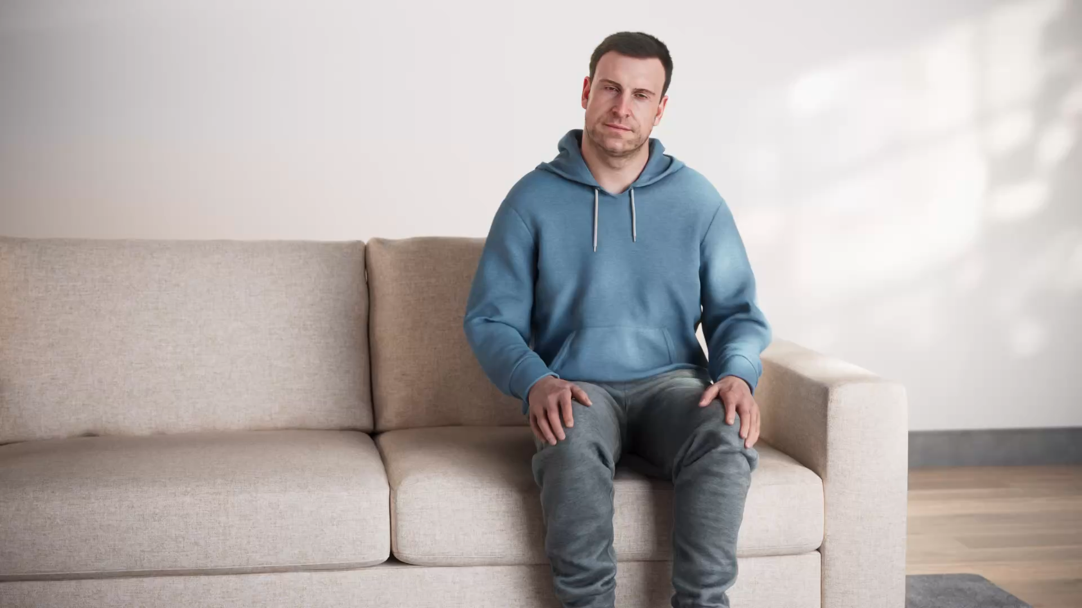
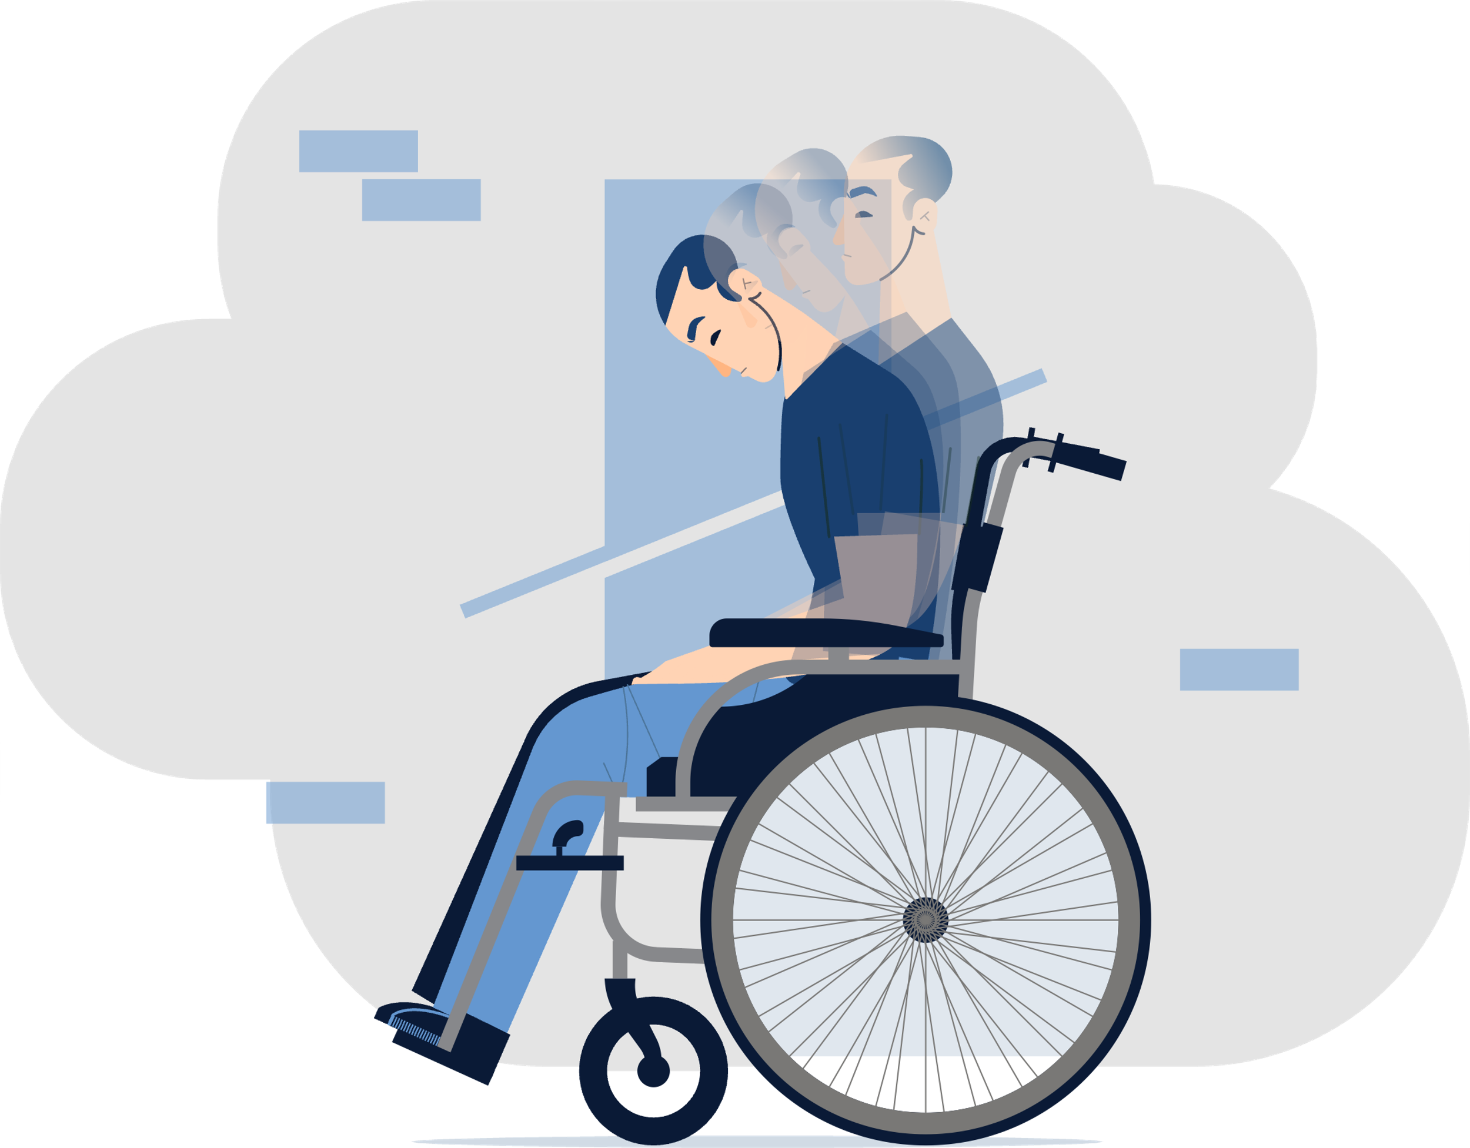


Atonic seizure (DROP SEIZURE)
Length
Atonic seizures last less than 15 seconds.¹
Head Drop
The individual’s neck muscles go limp, causing their head to suddenly drop or fall forward. Then, they immediately recover.¹
Muscle Weakness
The rest of the individual’s body also goes limp, like a rag doll. If they’re sitting, their body may slump forward. If they’re standing, they may fall over.¹
After The Seizure (Postictal)
The individual may immediately return to normal and continue doing whatever they were doing before.¹
CLICK TO VIEW FULL SCREEN VIDEO
SEIZURE TYPES
NEXT SEIZURE
Atonic seizures can often be confused with the act of dozing off (ex. an individual nodding off to rest while sitting upright, then abruptly waking up), or a behavioral tic.¹⁻³
References: 1. Kiriakopoulos E. Epilepsy Foundation. Accessed November 18, 2025. https://www.epilepsy.com/what-is-epilepsy/seizure-types/atonic-seizures 2. Mittal SO. Drugs Context. 2020;9:2019-12-2. 3. Mills S, Hedderly T. Ulster Med J. 2014;83(1):22-30.

Slide 7


Atypical absence seizure
Length
Atypical absence seizures normally last 5 to 30 seconds.¹
Blank Stare
The individual “blanks out” or stares into space for a short period of time, unaware of what’s going on.¹
Eye Movement
The individual’s eyes may turn upwards, then slowly close and open.²
Other Movements
The individual may also blink, make chewing movements with their mouth, smack or slightly jerk their lips, or rub their fingers or hands.¹
After The Seizure (Postictal)
The individual’s eyes and body return to normal, and they usually continue doing whatever they were doing before. If they experience several of these seizures back-to-back, they may be confused or tired.¹
CLICK TO VIEW FULL SCREEN VIDEO
SEIZURE TYPES
NEXT SEIZURE
Atypical absence seizures can often be confused with daydreaming, staring into space, or behavioral issues.²
References: 1. Kiriakopoulos E, Shafer PO. Epilepsy Foundation. Accessed November 18, 2025. https://www.epilepsy.com/what-is-epilepsy/seizure-types/atypical-absence-seizures 2. Kiriakopoulos E, Shafer PO. Epilepsy Foundation. Updated August 26, 2019. Accessed November 18, 2025. https://www.epilepsy.com/what-is-epilepsy/seizure-types/absence-seizures

Slide 8
Atypical absence seizure

Slide 9
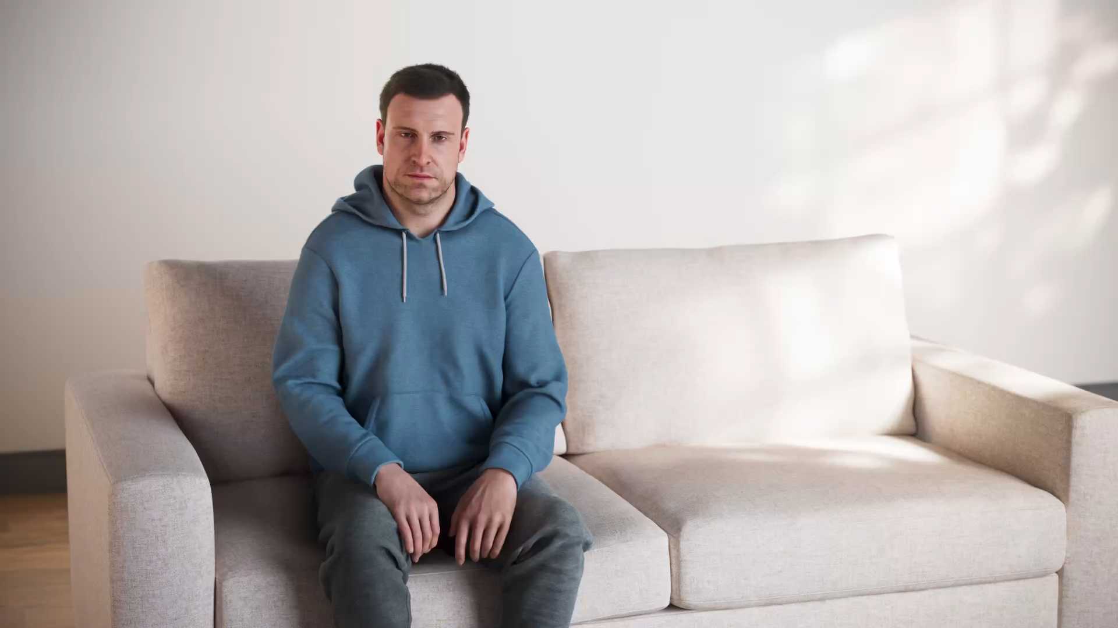

Focal impaired awareness seizure
Length
Focal impaired awareness seizures normally last 1 to 2 minutes, but can be several minutes long.¹⁻³
Eye Movement
The individual’s eyes and head may drift upwards or to one side.^{1,2}
Uncontrollable, Repetitive Movements
The individual may repeat behaviors in a way that seems intentional, but isn’t (ex. chewing or smacking their lips or picking at their hair or clothes).¹
After The Seizure (Postictal)
The individual returns to normal but looks confused or tired.¹
CLICK TO VIEW FULL SCREEN VIDEO
SEIZURE TYPES
NEXT SEIZURE
Focal impaired awareness seizures can often be confused with repetitive behavioral tics, daydreaming, or altered awareness as a side effect of medication.^{1,4}
References: 1. Kiriakopoulos E, Shafer PO. Epilepsy Foundation. Updated March 23, 2017. Accessed November 18, 2025. https://www.epilepsy.com/what-is-epilepsy/seizure-types/focal-onset-impaired-awareness-seizures 2. Kumar A, Ighodaro ET, Sharma S. In: StatPearls [Internet]. StatPearls Publishing. Updated March 19, 2024. Accessed November 18, 2025. https://www.ncbi.nlm.nih.gov/books/NBK519030/ 3. Epilepsy Foundation New England. Accessed November 18, 2025. https:// epilepsynewengland.org/knowledge-center/types-of-seizures/focal-impaired-awareness-seizures 4. Kaplan PW. Dialogues Clin Neurosci. 2003;5(2):187-200.

Slide 11

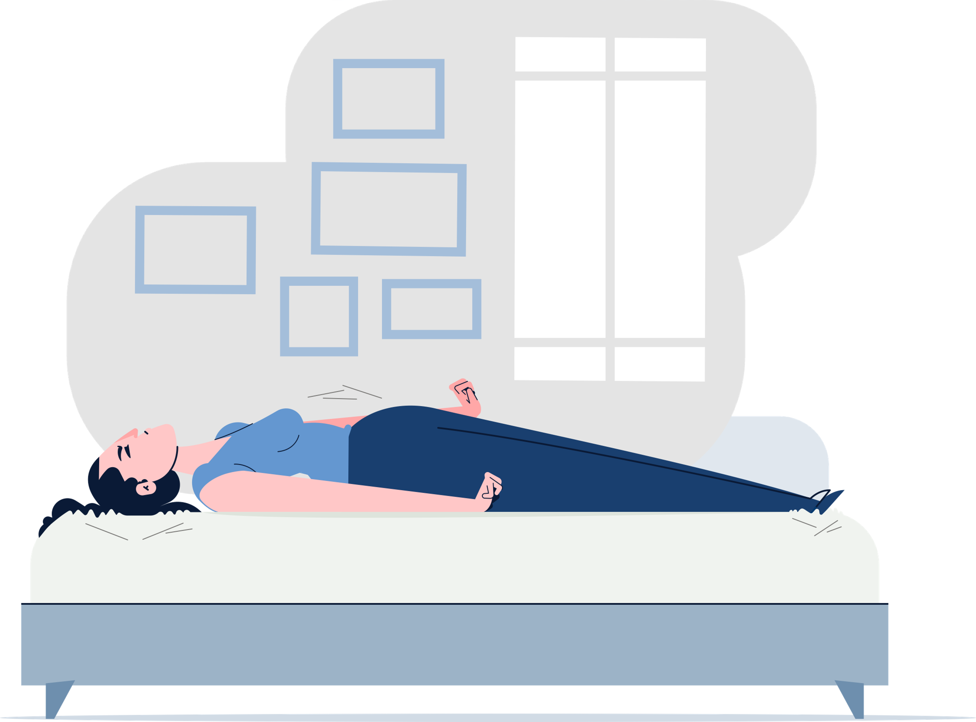
Tonic seizure
Length
Tonic seizures normally last less than 20 seconds.¹
Muscle Stiffness
The individual’s arm, leg, or other muscles suddenly tense/stiffen, and their hands may clench into fists or spread open.¹
Back Arching
The individual’s neck stiffens, and their back may arch dramatically.^{1,2}
During Sleep
The individual will often be sleeping when they experience this type of seizure, but it can also happen when they’re awake.¹
After The Seizure (Postictal)
The individual quickly returns to normal but may look confused or tired.¹
CLICK TO VIEW FULL SCREEN VIDEO
SEIZURE TYPES
NEXT SEIZURE
Tonic seizures can often be confused with nightmares or bad dreams.^{1,2}
References: 1. Kiriakopoulos E, Shafer PO. Epilepsy Foundation. Updated March 27, 2017. Accessed November 18, 2025. https://www.epilepsy.com/what-is-epilepsy/seizure-types/tonic-seizures 2. Duncan AH, Peric I, Boston R, Seneviratne U. J Neurol. 2022;269(4):2172-2178.

Slide 13
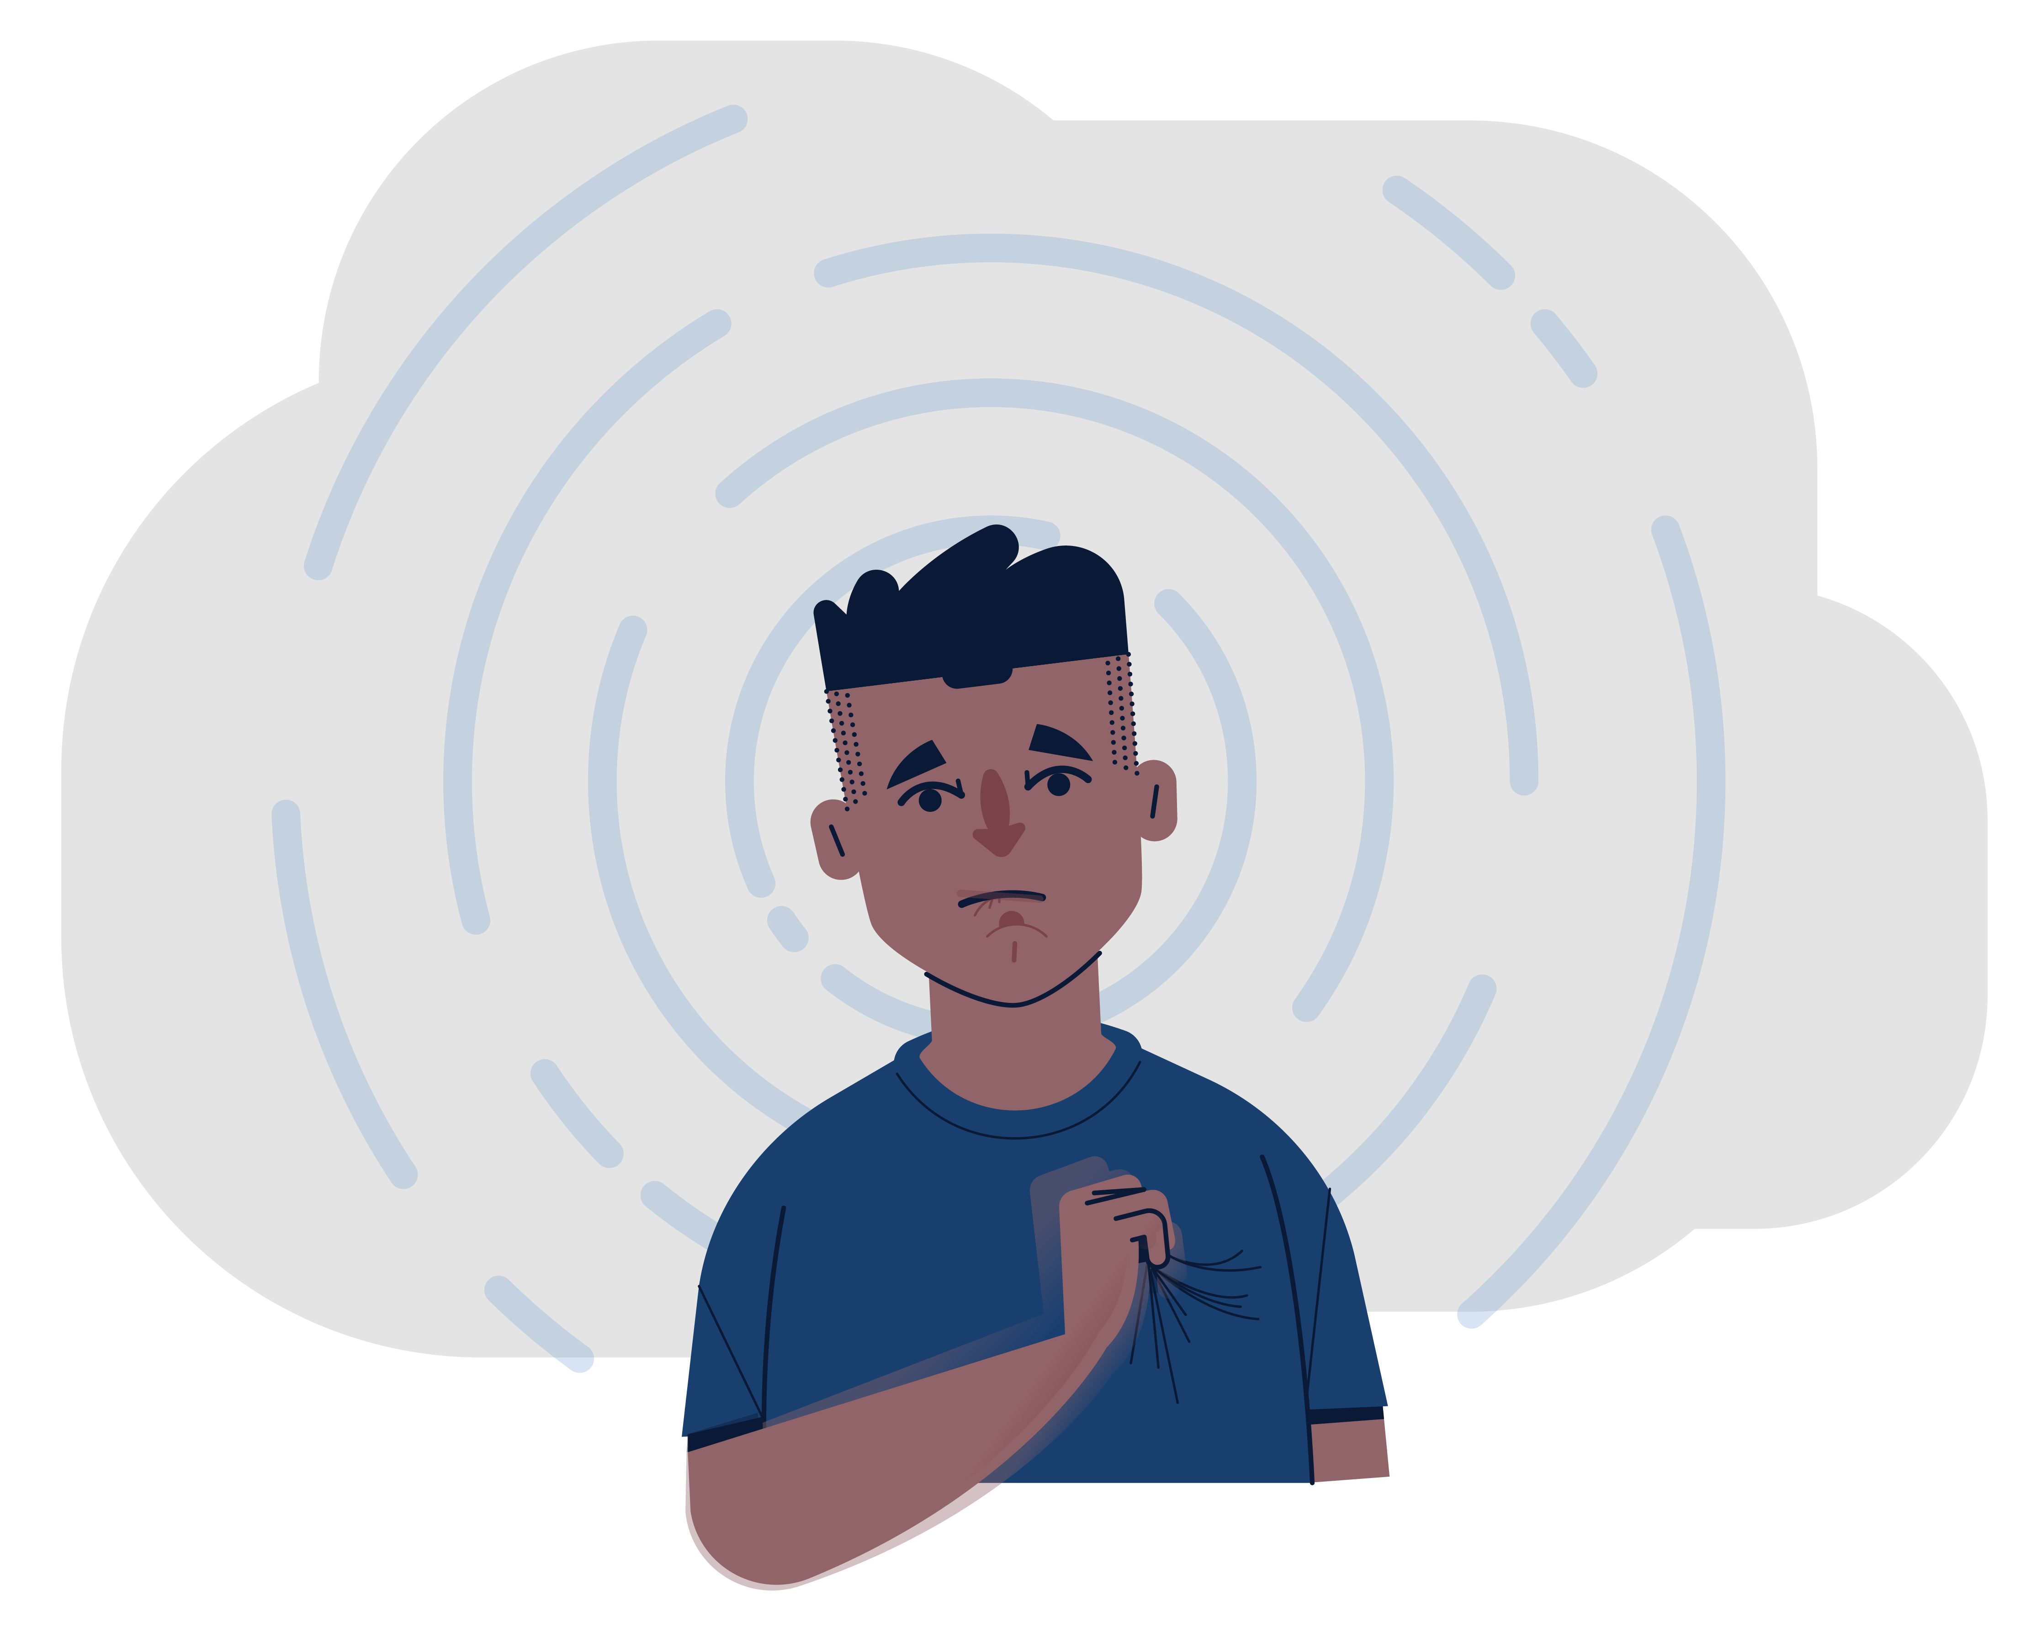
Focal aware seizure
Length
Focal aware seizures normally last less than 2 minutes.¹
Awareness
The individual is fully awake and aware of what’s happening.¹
Body Shaking
The individual may shake, twitch, or move one side of their body (ex. mouth or arm).¹
Changing Senses
The individual may experience changes in their senses or emotions (ex. taste/smell/vision/hearing, feelings of joy/fear, nausea, etc).¹
After The Seizure (Postictal)
The individual usually continues doing what they were doing before the seizure and can recall what happened during the seizure.¹
SEIZURE TYPES
NEXT SEIZURE
Focal aware seizures can often be confused with migraines or the side effects of some medications (ex. changes in taste, smell, vision, or hearing).¹
Reference: 1. Kiriakopoulos E. Epilepsy Foundation. Accessed November 18, 2025. https://www.epilepsy.com/what-is-epilepsy/seizure-types/focal-onset-aware-seizures

Slide 14
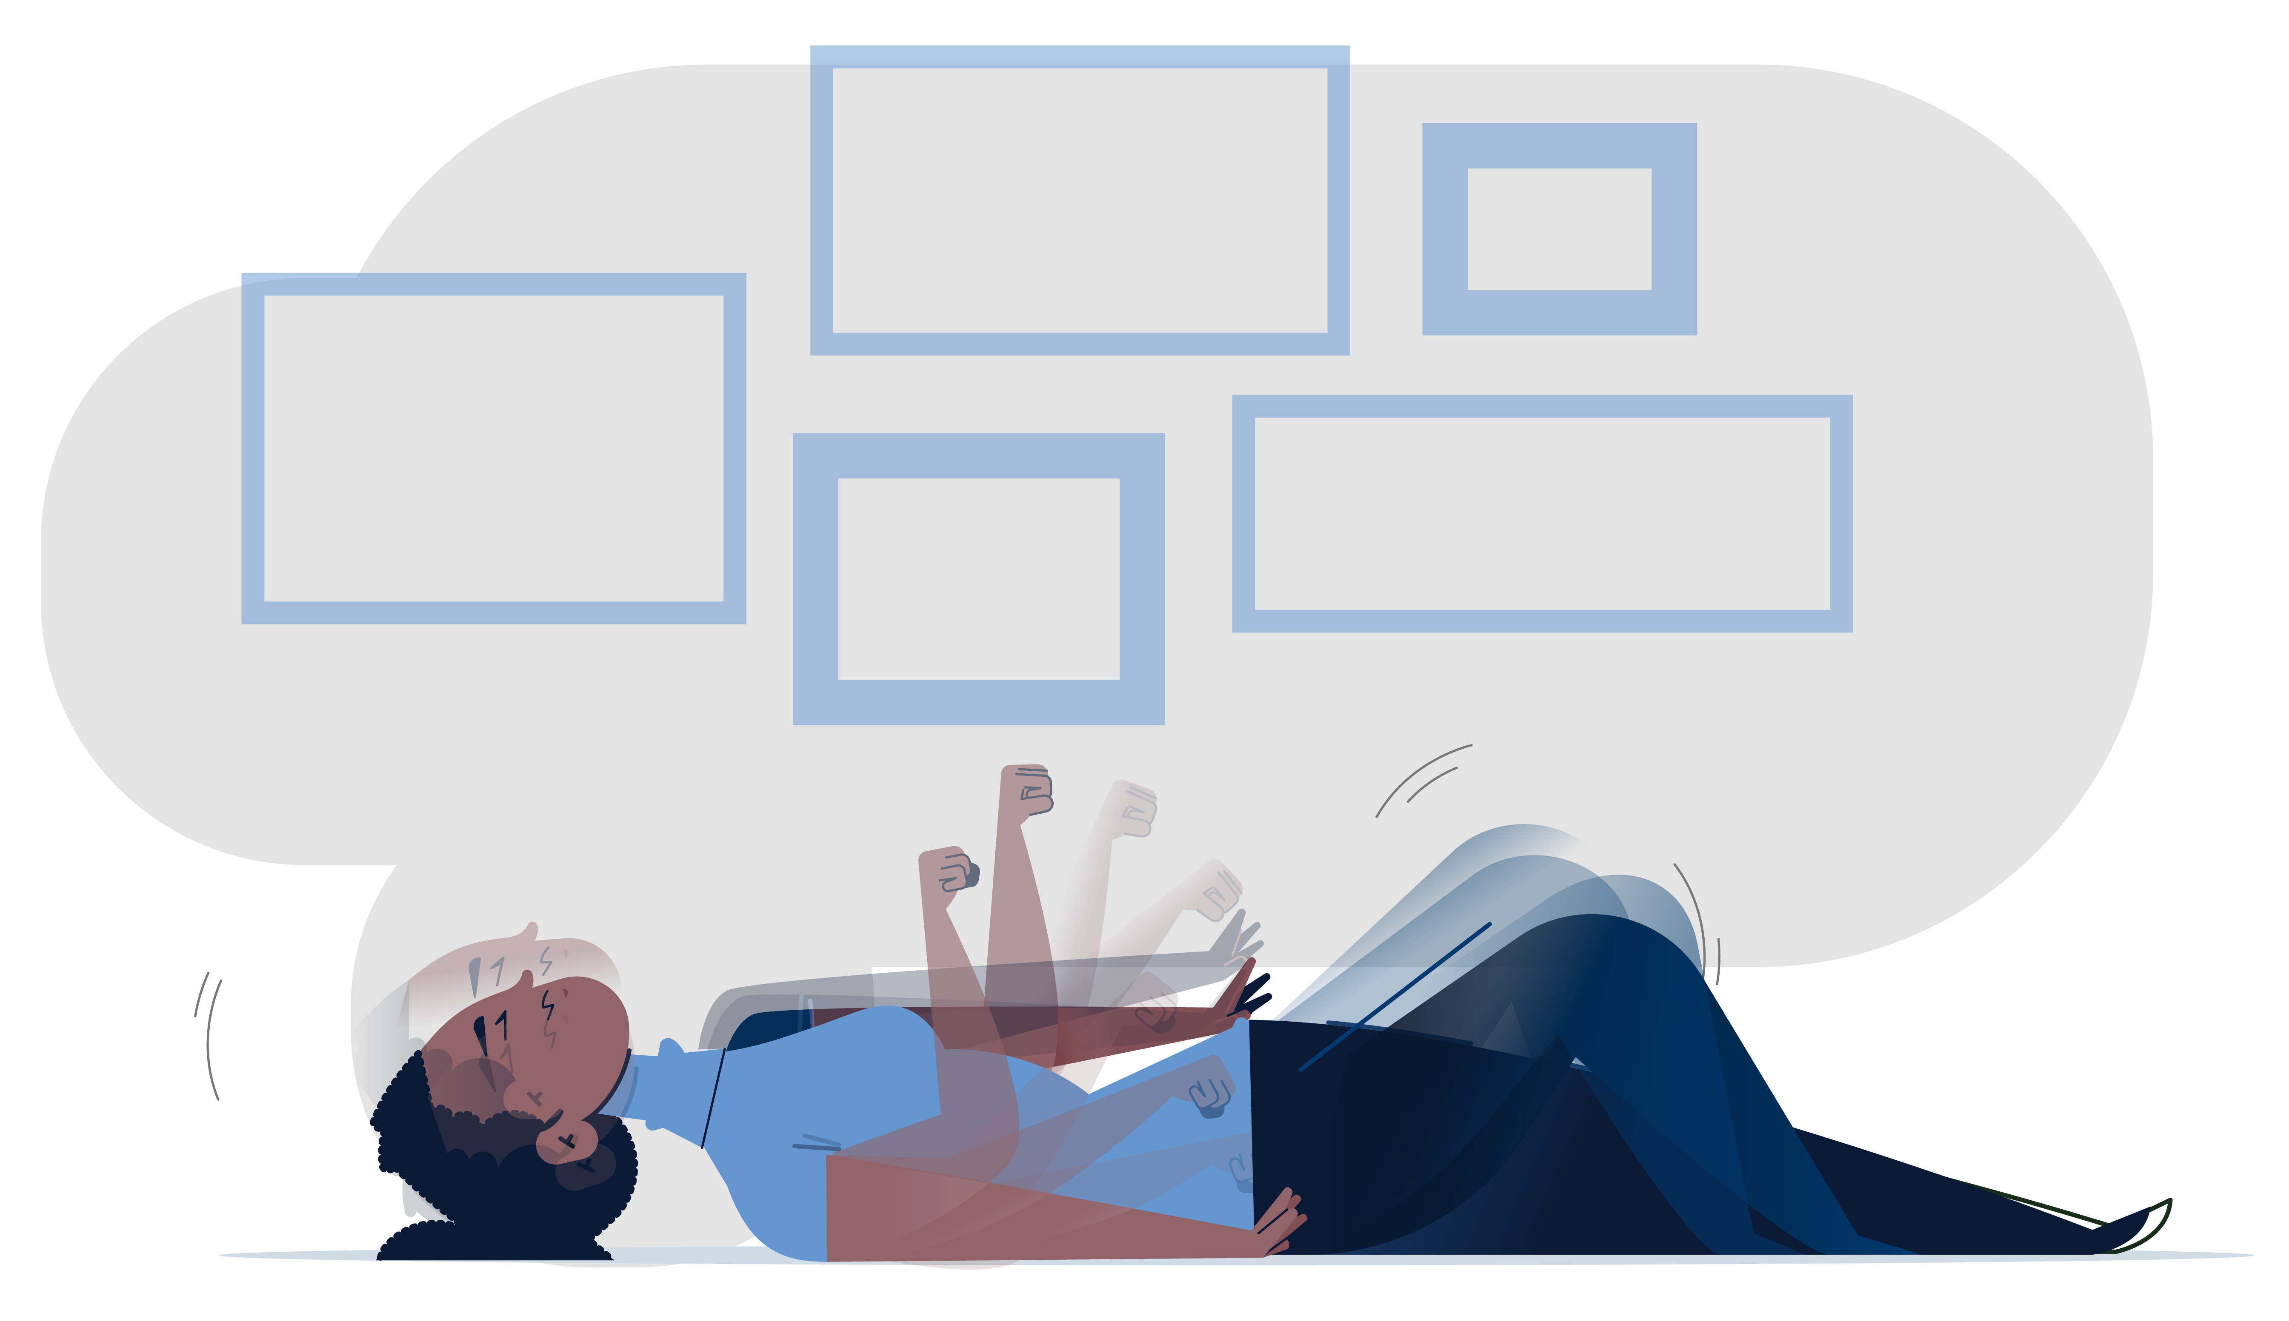
Generalized tonic-clonic seizure
Length
Generalized tonic-clonic seizures normally last 1 to 3 minutes.¹
Muscle Stiffness
The individual’s muscles stiffen, then they lose consciousness and fall to the floor.¹
Uncontrollable Jerking
The individual’s arms and legs then jerk repeatedly.¹
Uncontrolled Bodily Fluids
The individual may drool or lose control of their bladder/bowels.¹
After The Seizure (Postictal)
The individual may be sleepy, confused, or irritable.¹
SEIZURE TYPES
NEXT SEIZURE
Generalized tonic-clonic seizures may be confused with fainting.¹
Reference: 1. Kiriakopoulos E, Shafer PO. Epilepsy Foundation. Updated March 15, 2017. Accessed November 18, 2025. https://www.epilepsy.com/what-is-epilepsy/seizure-types/tonic-clonic-seizures

Slide 15
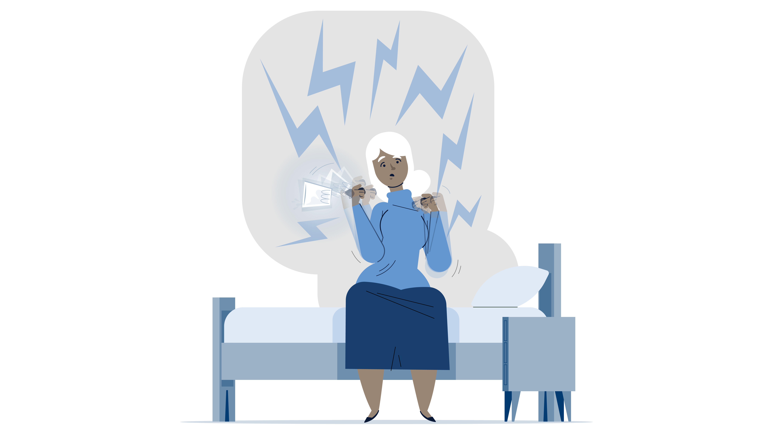
Myoclonic seizure
Length
Myoclonic seizures normally last 1 to 2 seconds, but sometimes they happen back-to-back.¹
Uncontrollable Jerking
The individual’s muscles jerk uncontrollably, like they got an electric shock.¹
Clumsiness
The individual may drop objects or sometimes fall.¹
Waking Up/Falling Asleep
The individual will often be waking up or falling asleep when they experience this type of seizure.¹
After The Seizure (Postictal)
The individual usually continues doing what they were doing before the seizure.¹
SEIZURE TYPES
SEIZURE TYPES
NEXT SEIZURE
NEXT SEIZURE
Myoclonic seizures can often be confused with tics, tremors, or clumsiness.¹
Reference: 1. Sirven JI, Devinsky O. Epilepsy Foundation. Updated July 19, 2013. Accessed November 18, 2025. https://www.epilepsy.com/what-is-epilepsy/seizure-types/myoclonic-seizures

Slide 16




WHEN YOU SEE A SEIZURE, LOG IT
Looking out for seizures means looking out for your residents.
When a seizure strikes like a STORM, document these details:
S
START DATE AND TIME
When did the seizure happen? (ex. Monday 7/14 at 12:35 PM)
T
TOTAL LENGTH
How long did the seizure last?
(ex. less than 1 minute, 1 to 2 minutes, or around 5 minutes)
O
OBSERVED SYMPTOMS
Which side of the body did the seizure affect first? What happened during it?
(ex. seizure started on left side; they tensed up, stared blankly, or fell)
R
RELATED EVENTS
Did anything seem to cause, or trigger, the seizure?
(ex. showed signs of infection, constipation, or emotional stress)
M
MOMENTS BEFORE AND AFTER
How did your resident act before and after (postictal) the seizure?
(ex. agitated, confused, or sleepy)

Slide 17

SAM’S story
Sam has been one of the group home's favorite residents since he moved here a year ago at the age of 35. He’s lived with drug-resistant epilepsy for most of his life.
Recently, Katie, a new Direct Support Professional, started caring for him. She noticed Sam was daydreaming a lot during their time together. At first, it seemed harmless, until she remembered that atypical absence seizures can be confused with daydreaming or staring off into space.
Understanding every seizure is worth reporting, Katie kept track of Sam’s “daydreams” for the next week and sent a detailed log to David, her Director of Nursing.
Today, Sam is experiencing fewer seizures and engaging more with his fellow residents.
If it hadn't been for Katie and David logging seizure activity for Sam's neurologist to review, that would not have happened.
Things to bring to every appointment:​
Seizure logs​
Face sheet
Medication records​
Lab results​
Based on a hypothetical resident in long-term care.

Slide 18



See a seizure, help make a difference
If you think a resident is experiencing any of the seizures we've discussed today, talk to your care team
Report concerns promptly—you don’t need to wait for the next doctor’s appointment
Always bring your resident’s seizure logs & other important forms to their doctor’s appointment
If a resident is experiencing 2 or more of the seizure types we've reviewed today, fill out the Refractory Epilepsy Screening Tool for LGS—or encourage your care team to fill it out.
Scan for screening tool

Slide 19
Thank YOu
Scan the QR code or visit SeeASeizure.com to rewatch the seizure videos we saw today.

